Slide 1
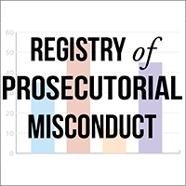
REGISTRY OF
PROSECUTORIAL MISCONDUCT:
Pointing the Way to
Innocence Reform

Slide 2
Did you know?
Fact #1: Since 1989, there have been over 1,400 documented cases of persons who have been convicted and later exonerated.
Fact #2: An estimated 43% of wrongful convictions arise from misconduct involving prosecutors and other officials, according to the National Registry of Exonerations.
Fact #3: Many different types of ethical violations have been reported. The most common is failure to disclose exculpatory evidence (Brady violation)
Fact #4: Fewer than 2% of cases of prosecutor misconduct are subject to public sanctions.

Slide 3
Background
Registry of Prosecutorial Misconduct was established in January 2014
Traffic: 4,000-5,000 page views each month
Can be accessed at: www.prosecutorintegrity.org/registry
Sponsored by the Center for Prosecutor Integrity, a 501(c)3 organization
CPI’s mission:
-- Promote prosecutorial accountability
-- Restore the presumption of innocence
-- Bring an end to wrongful convictions

Slide 4
Purposes
Promote awareness of prosecutorial misconduct
Establish a mechanism for accountability
Summarize accounts of misconduct
Provide data for research projects
Evaluate effectiveness of statewide policy reforms

Slide 5
Media Coverage
“Now for some good news: A nonprofit reform group called the Center for Prosecutor Integrity (CPI) has just launched a new registry of prosecutor misconduct. It’s searchable by name, case, date, and several other variables. It also looks to provide some interesting data breaking down misconduct by infraction, region, and so on.” — Radley Balko, Washington Post, January 9, 2014

Slide 6
Why a Registry?
Ineffectiveness of existing accountability mechanisms:
Weak judicial reporting requirements
Fewer than 2% of cases reported to disciplinary bodies result in public sanctions
Even when imposed, sanctions are often a “slap of the wrist”
Absolute immunity of prosecutors from civil suits

Slide 7
Criteria for Inclusion
Cases are included in the Registry only if there is a finding of prosecutor misconduct by a:
Trial Court
Appellate Court
Supreme Court
Legal Disciplinary Body

Slide 8
Definition of Prosectorial Misconduct
The Registry defines prosecutorial misconduct as any conduct, intentional or inadvertent, during the course of prosecution that:
Violates the applicable code of professional ethics,
Breaks a pertinent law, or
Prejudices, or appears to prejudice the administration of justice

Slide 9
Case Review and Data Entry - I
Identify potential case:
Cases submitted by individuals
Media reports
Lexis-Nexis database

Slide 10
Case Review and Data Entry - II
Confirm case eligibility, based on finding by a:
Trial court
Appellate court
Supreme court
Bar disciplinary committee

Slide 11
Case Review and Data Entry - III
Data entry into database by Legal Analyst
Final case review and approval by Registry Director

Slide 12
Registry Fields
Case number
Citation
Crime
State where crime was committed
Prosecutor name
Federal jurisdiction
Year of trial
Body making finding of prosecutorial misconduct
Finding summary
Year of finding
Type of misconduct
Conviction/Sentence Effect
Prosecutor Misconduct Reported
Sanctions
Type of sanctions
Date Published

Slide 13
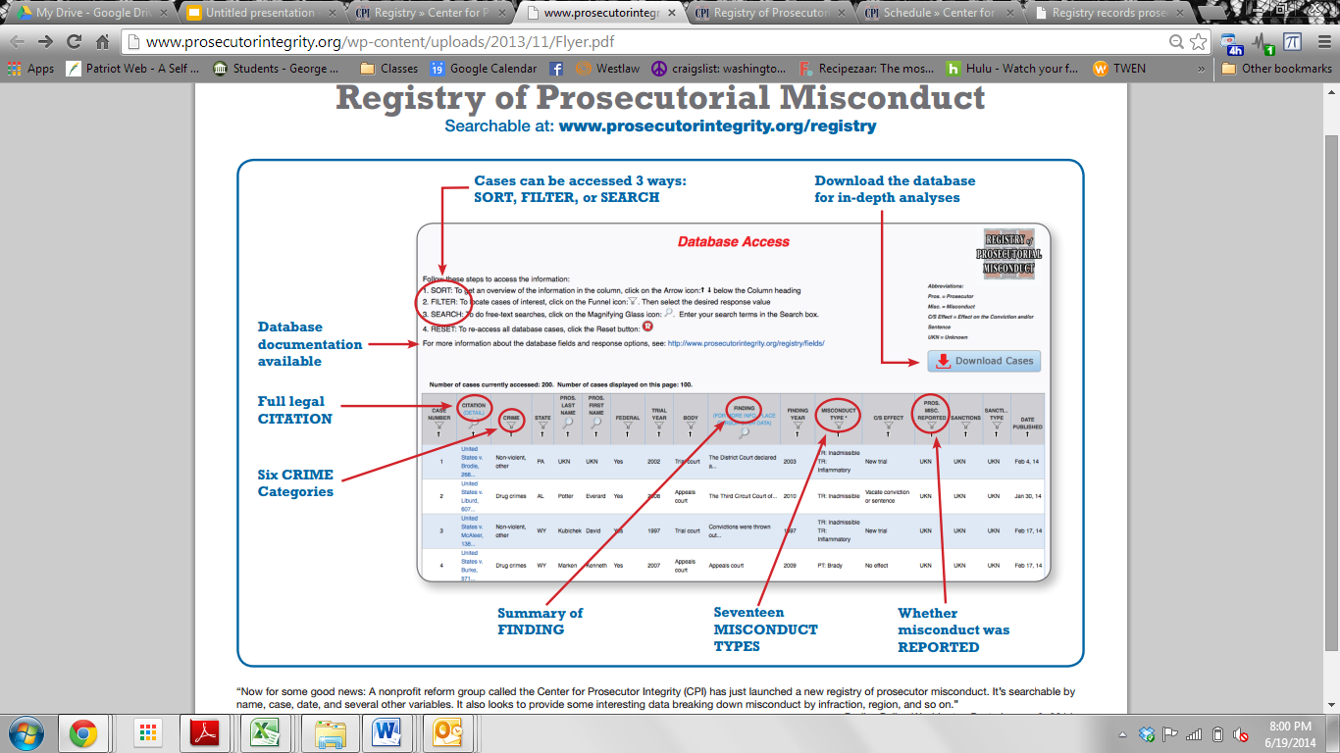

Slide 14
SAMPLE Opinion

Slide 15
RESEARCH OPPORTUNITIES
Registry allows for a variety of research projects:
-- Compare jurisdictions
-- Assess trends
-- Identify most common types of misconduct – see next slide

Slide 16
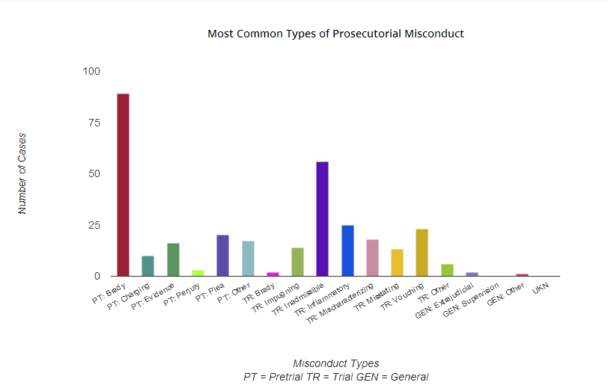

Slide 17
Plans for Expansion
-- An estimated 16,000 findings of prosecutorial misconduct have been made in the United States since 1970
-- CPI is partnering with state lawmakers, criminal justice groups, civil rights organizations, and others to continue to expand the Registry

